Slide 1

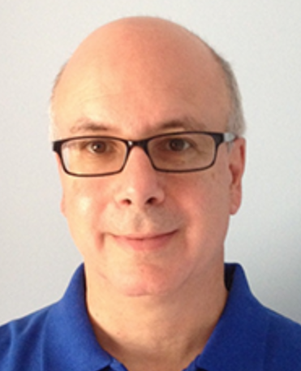
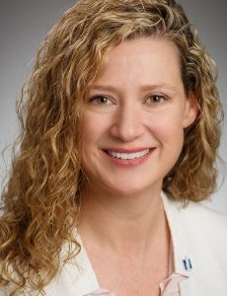
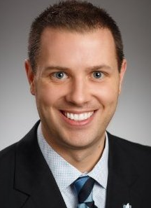
EPISODE 3: THE QUEST FOR ACCELERATED DELIVERY
NOVEMBER 7, 2016
CARMEN DEARDO TECHNOLOGY LEADER,
NATIONWIDE IT
CINDY PAYNE DIGITAL SOLUTIONS ARCHITECT,
NATIONWIDE FINANCIAL
JIM GRAFMEYER DIGITAL ARCHITECT,
NATIONWIDE FINANCIAL

Slide 2

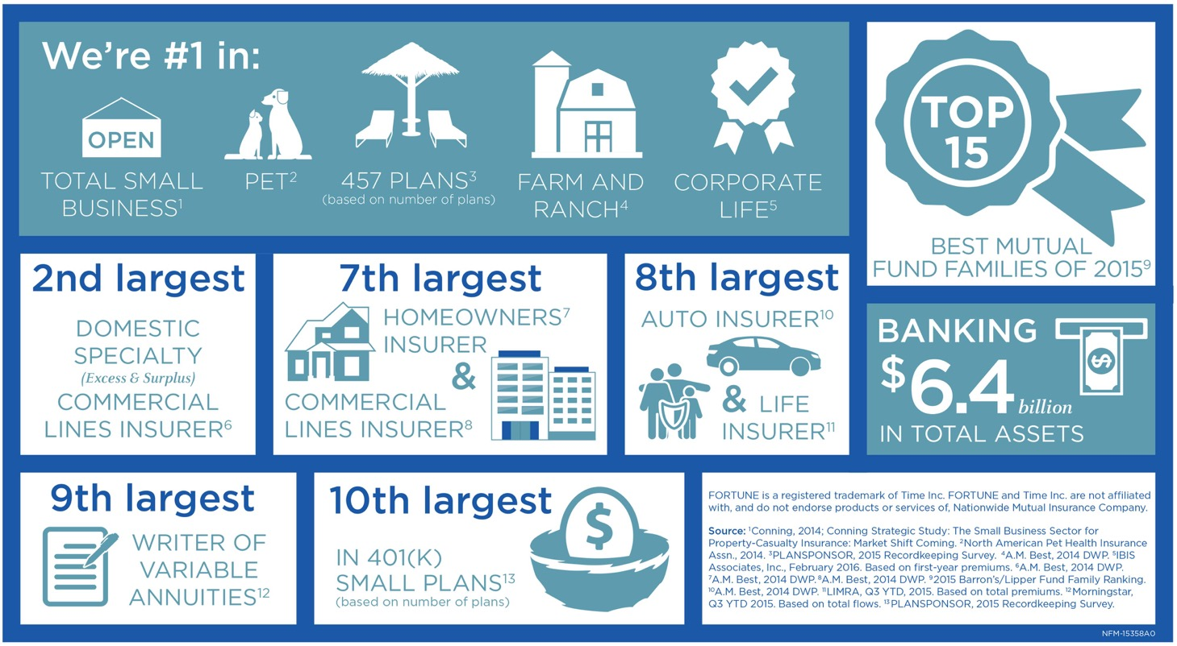


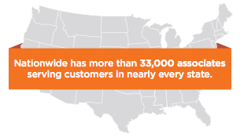
THRIVING IN A DYNAMIC, HIGHLY-REGULATED WORLD
16+
#9
WRITER OF VARIABLE ANNUITIES
MILLION
POLICIES
$355
$195.2
BILLION
IN ASSETS
MILLION
CONTRIBUTED
TO NONPROFITS
AND COMMUNITIES
SINCE 2000
FOUNDED IN 1926
BY MEMBERS OF
THE OHIO
FARM BUREAU
#69
ON THE
FORTUNE
500 LIST
33,000 Nationwide associates serve customers in every state
8
th
LARGEST
COMMERCIAL
INSURER

Slide 3

EPISODE 1: A NEW HOPE – AGILE AT SCALE
200+
AGILE / LEAN STANDING TEAMS
800+
BUILD PROJECTS EXECUTED ANNUALLY
FIRST PHASE: AGILE DEVELOPMENT
NEXT PHASE: APPLICATION OF LEAN ACROSS THE DELIVERY LIFE CYCLE
25%
75%
ESTABLISHED
BALANCE
CI
CT
CD
OF
INNOVATION
ANNUAL INCREASE IN NUMBER OF AGILE TEAMS
OF ALL PROJECT WORK DONE BY AGILE TEAMS
AND
DISCIPLINE
PRACTICES

Slide 4




RESULTS: SO FAR, SO GOOD
QUALITY
PRODUCTIVITY
80%
82%
REDUCTION IN CRITICAL DEFECTS
86%
REDUCTION IN HIGH DEFECTS
OF AGILE TEAMS MOVED INTO TOP TWO INDUSTRY QUARTILES (QSM)
SYSTEM AVAILABILITY
DELIVERY
90%
ON TIME DELIVERY
INCREASE IN USER’S OVERALL SYSTEM AVAILABILITY
70%
60%
VS
PREVIOUSLY

Slide 5
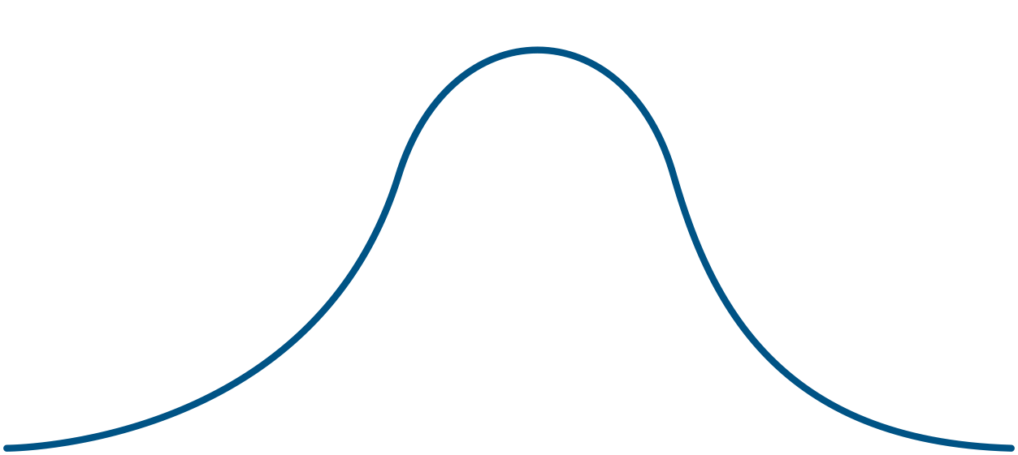
MORE WORK TO DO
Water-SCRUM-Fall
Teams waiting for work due to “discrete” planning processes
Delivery slowed down by manual and high ceremony processes
SPEED
High Acceleration during Design, Develop and
Acceptance Testing
0
TIME
Notes:
Optimized the middle
Very slow getting work into lines (starvation)
Very slow cycle time from business idea -> card on board
Very slow cycle time from code commit -> prod deployment

Slide 6


EPISODE 2: DISCOVERING THE DELIVERY VALUE STREAM
BUILDS
RELEASE PLANNING
DESIGN / DEVELOP
READINESS CERTIFICATION
DEPLOY
BUSINESS
MONITORING & FEEDBACK
CREATE STORIES
DEVELOP CODE & AAT
BUILD & CI
DEPLOY TO TEST ENVIRONMENT
EXECUTE TESTS
CERTIFY

Slide 7
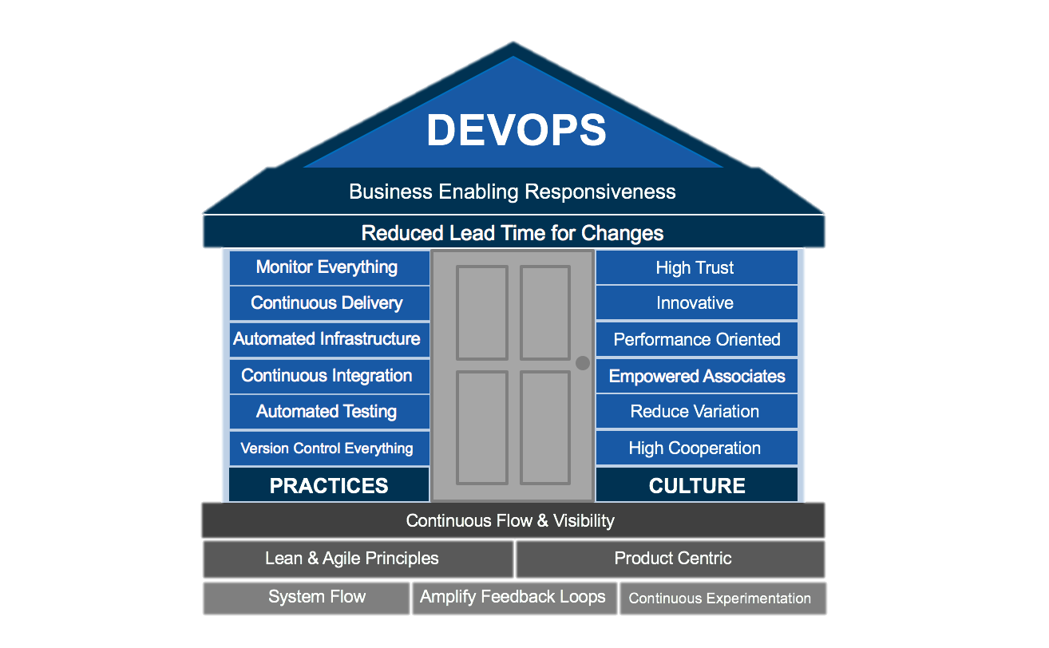

EPISODE 3: QUEST FOR ACCELERATED DELIVERY
True North:
Reduced lead time for changes
Business enabling responsiveness

Slide 8



ORGANIZATIONAL STRUCTURE
Nationwide IT
I & O
Shared Services
Business Units
Tool Owner
Nationwide Financial
Tool Owner
Carmen
Cindy
Tool Owner
Jim
Notes:
Introductions and where we fit into the org chart
Shared services organization: Carmen lives there, building enterprise capabilities
Accountable/responsible
Business units: Nationwide Financial and Property/Casualty
Cindy/Jim are in Nationwide Financial: lead architects for Digital Assets: we serve X, Y, Z
We’re great at the “scrum” part:
Accountable/responsible : we need to optimize for speed
We often depend on back office systems that can’t deliver as fast, but we need to figure to work around
We have counterparts in Property/Casualty who are trying to do the same thing

Slide 9


MODEL LINE CONCEPT
PRINCIPLES
Nationwide Financial and P&C model lines
Used to “model” behavior to scale a large organization
Demonstrate what works more powerful than preaching what might or should work
Experiment and develop patterns for other organizations to mimic
Notes:
Jim/Cindy start here?

Slide 10
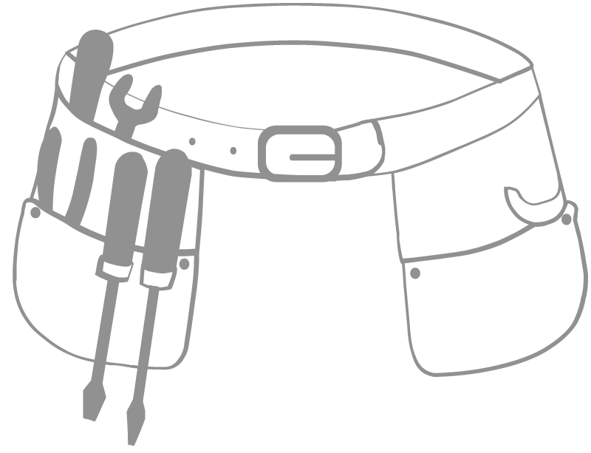


NF MODEL LINE: MAKING IT REAL
The CHALLENGE for practitioners is making incremental progress when moving forward with a HALF-EMPTY TOOL BELT,
while being judged on a CALENDAR YEAR
and having to demonstrate they’re getting FASTER.
Notes:
(Jim Slide)
Ivory tower joke to transition
How to demonstrate progress with half empty tool belt, calendar year, speed (visual slide)
Our true north: Speed!
Gene's talk to Nationwide: Optimize for speed
Carmen is bringing in tools for obvious gaps (UCD/UCR)
Theme of model line: Innovation w/ business area and Enterprise Transformational initiative. One without the other does not provide value.
Harder case is tools that need replaced for capability uplift
-----------------------
Cindy/Jim: Nationwide Financial (specific business unit at Nationwide, model line)
One of top goals: accelerating solution delivery
We’re also try to speed up adoption of changes
Model line: from Lean parlance: adopt as many tools and practices as quickly as possible
The problem we faced
We get all excited when we get together, go back to buildings, and revert to not talking with each other
Getting off of local tools: Carmen created great reference tools, but we’ve solve many of them
Risk averse culture: creates slow decision making; that’s very typical for an insurance company
What we did to
Expanded scope: GitHub maybe not top of Carmen’s tool chain, but it is one of ours
What happened
Metrics and outcomes
Code deployment lead times, deployment outcomes
Evidence of improved customer outcomes: NPS, larger budgets
Progress: two capability lists
DevOps capabilities: practices, culture, goals, prioritize
12 factor app attributes
(Decision velocity issues around infrastructure provisioning)
What went wrong

Slide 11









Internal Cloud
NF MODEL LINE: TOOLING
Delivery
From every server
custom built to auto
provisioned
Speed to Market
From months to hours
for Java applications
Costs
From $$$$$
to $$
Configuration
From complex
and wide variations
to simple and standard
Self Managed
Work requests required
went from 100% to 0%
Patching
From operations initiated
to user initiated
Notes:
(Cindy Slide)
SVN -> GitHub (make the code central to everything vs process)
Inner-sourcing, collaboration, much faster merges
Talk about pain with code reviews
HP Suite -> New Relic (90% uplift in capability features)
Manual log curation -> Splunk
Nitro metrics vs traditional physical hosting (self-service trumps standardization trumps snowflakes)
Don’t need to actually use these:

Slide 12


NF MODEL LINE: 2 SPEED APPLICATIONS
Large app releases decreased by
80%
SEPARATION
replaced by
per month
small presentation tier deploys
150
Presentation Tier
Business Tier
Notes:
Separation of business tier from presentation tier (Need branding for this)
Did it out of business need without any enterprise tooling or permission
Results: Large app releases decreased by 80%, replaced by 150 small presentation tier deploys per month
Made it "free" to make changes to pres tier
(Jim Slide)
Buying a tool cannot achieve this
Business is happier with results without a CMS
Process is leaner
Recent progress: MVC framework moved from Struts to Angular and can leverage content process
Example: adding pages can now be done in hours vs months
Need to get statistics on campaign solution

Slide 13

NF MODEL LINE: ARCHITECTURE CHANGES
FACTOR
The GOAL is to utilize
to build a minimal, portable, and scalable architecture with
12
FEATURE TOGGLING
capabilities to support dark and canary launches and multivariate testing.
Notes:
(Cindy Slide)
Tools are not enough – need app/architecture changes as well
12 Factor
Manifesto for building a minimal, portable, and scalable architecture
Control what we can control. We know we have issues around I&O but we need to have our own house in order first
Example: treat all dependencies as services that can be easily attached and detached (including databases and file system)
Microservices/APIs are necessary to decouple from systems of record
Feature Toggling: Define dark launches, canary launches, multi-variate
Surprised that business could not accept changes as fast as we could develop then – highly regulated
Need to get good at this to continuously deliver

Slide 14
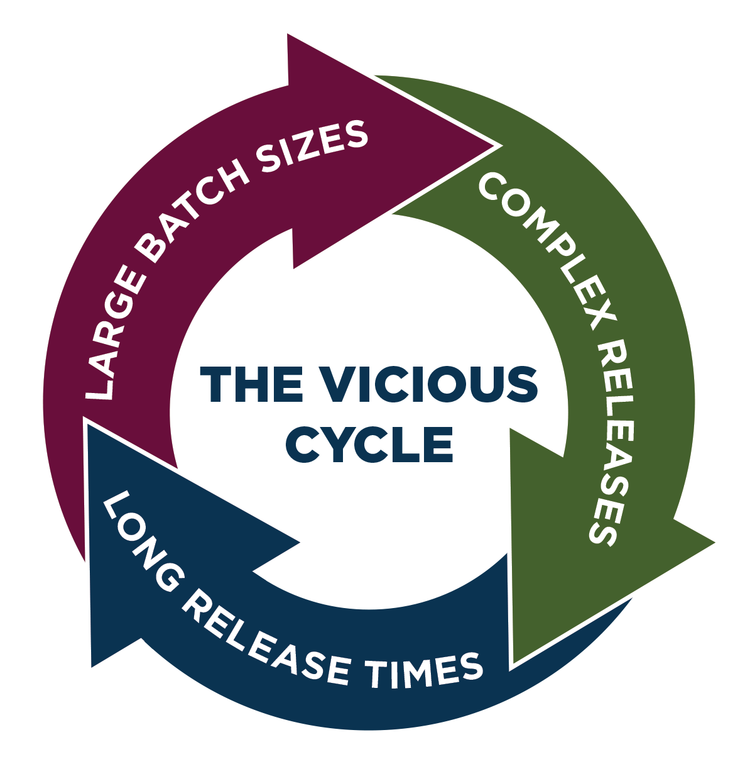
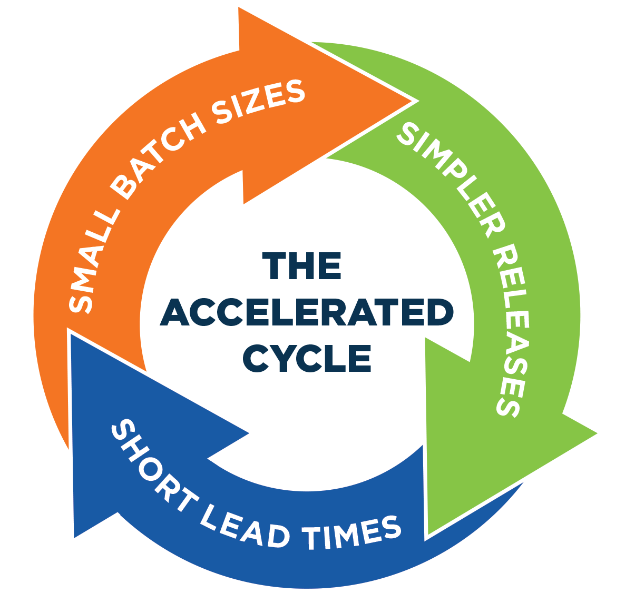


NF MODEL LINE: IT’S MORE THAN TECHNOLOGY
READINESS BASED RELEASES
TIME BASED RELEASES
Notes:
(Jim Slide)
Small batch sizes: we thought we could control, but it's a larger nut to crack (business, planning teams, etc)
Current process: "Slowest common denominator". One size fits all, regardless of batch size
Shift from time based release -> readiness based

Slide 15

WHAT WE GAINED
RESULTS
Credibility to drive Culture Change
Model Lines demonstrate what’s possible
Model Lines are showing that Innovation and standardization can be compatible (Disciplined Innovation)
Results to Motivate Transformation
Model Lines are solving real Business Problems Faster which motivates other Business Areas
Model Lines are respected Leaders in the organization whose story is a powerful agent for Transformational Change

Slide 16


WE STILL NEED HELP EPISODE 4: BEYOND ACCELERATED DELIVERY
Funding Model and Business Readiness
Decision Velocity due to risk adverse Culture
DevOps Ecosystem perspective for Technology decisions rather than Individual Tool Justification
ITSM and Continuous Delivery Automation
Audits and Security Traceability
Trust in Automated Deployment and Certification
Notes:
Help areas – less focus on transient projects and more on releases

Slide 17
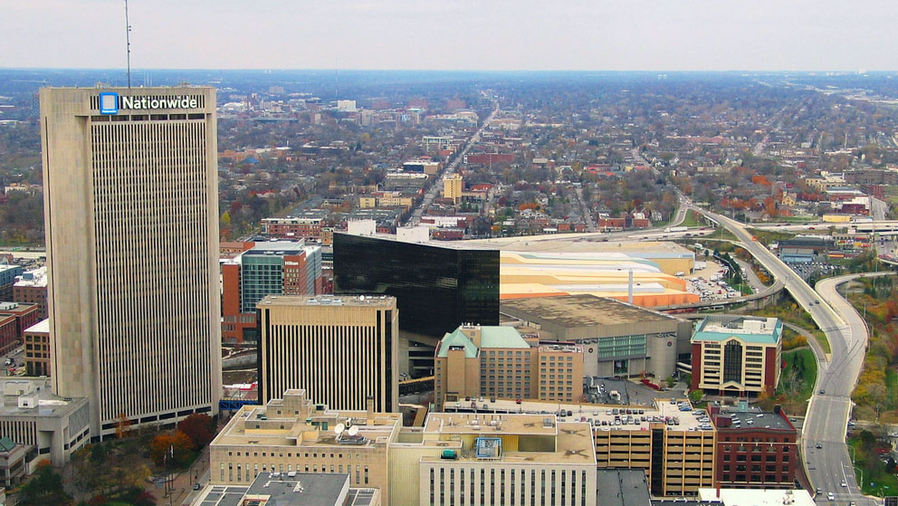
CREDITS
ICONS
Designed by thenounproject.com
SPACESHIP
Designed by Freepik

Slide 18

THANK
Y U

